Slide 1
NE 763: Advanced Reactor Materials
Fall 2025
Dr. Benjamin Beeler

Slide 2
Housekeeping
All should have received exam grades and presentation grades/comments
Please come to me with any questions, concerns, comments, etc.
Hopefully some presentation comments are helpful

Slide 3
Last Time
Introduction to research reactor fuel
Key features:
low temperatures, no gap or plenum, high burnup
Primary type is dispersed particles of metallic compound/alloy in a fuel block embedded in Al matrix; key features often include solid/gaseous swelling, interaction layer growth, and amorphization
Intro to both Alx and USi RR fuels
USi-type fuels have a higher density than UAlx, but swell significantly more
U3Si2 has more stable bubble morphology than U3Si, due to their amorphous behavior

Slide 4
Blister Testing
A unique measure for sound fuel performance considered in research and test reactors is ‘blister threshold temperature’ testing with irradiated plates
Because there is neither a gap nor a plenum, no fission gas release is possible outside of the fueled zone
Fission gas and any gas included during fabrication remain in the fueled zone; in particular, fission gases are contained in pores or fission gas bubbles
Gas pressure in large pores and fission gas bubbles, which may be insufficient to cause detrimental creep or yielding of fuel, could instead result in blistering of a fuel plate when the plate is heated to a certain temperature
Two types of mechanisms can be considered for blistering: pore (or void) connection, and pressure rupture of fission gas bubbles

Slide 5
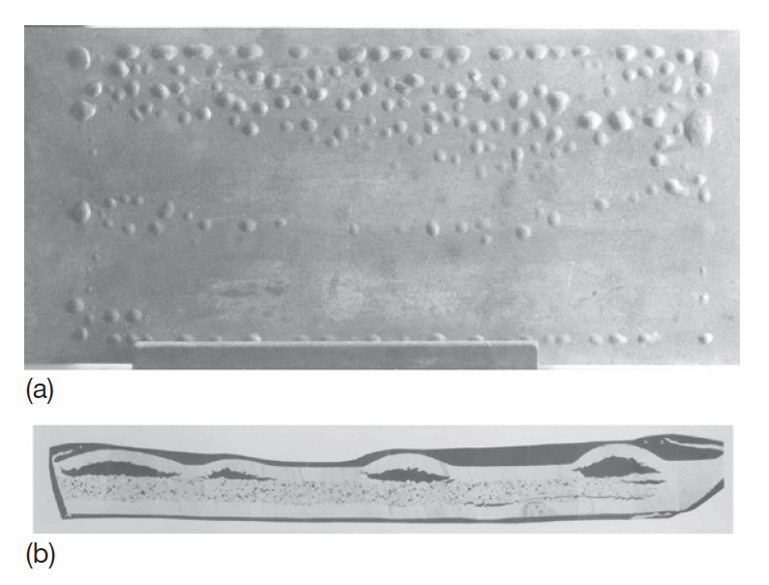
Blister Testing
In the typical blister test, the sample plate is held at a specified temperature for 30–60 min during each annealing step
The temperature at which blisters form is termed the ‘blister temperature’
Images of a U3Si2–Al dispersion fuel plate after a post-irradiation blister test at 450C

Slide 6
USi Blistering
For typical fuel particle loadings, miniature scale plates of U3Si2 and U3Si were blistered in the range of 515–530C
An increase in fuel loading dropped the blister temperature by about 75C
When boron is added, the blister threshold temperature decreases by about 100C, similar to what is observed in UAlx fuels
Boron is added as a burnable absorber in certain research reactor fuel designs as a means of flux/temperature balancing to avoid hot spots
The blister threshold temperature for U–Si intermetallic dispersion fuels is less sensitive both to burnup and to fuel volume loading than UAlx dispersion fuels

Slide 7
USi Summary
U3Si2 is presently considered the best qualified fuel in terms of uranium loading and performance for research and test reactors
U3Si is unsuitable for a plate-type geometry because of unstable swelling, it is still considered for fuel rods
The ILs in U3Si2/Al are free of porosity formation at reasonable burnups and the IL growth is considered reasonably slow
Both U3Si and U3Si2 are amorphized under irradiation, but have inherent differences in fission gas bubble growth
U3Si has excessive breakaway swelling, whereas U3Si2 has stable, albeit still large, swelling

Slide 8
RERTR to U-Mo
Failure to convert high-power research reactors using HEU to LEU U3Si2 resulted from the need for fuels of even higher uranium density
The fuel development effort has shifted to uranium–molybdenum alloys with Mo content ranging 6–10wt%, in both monolithic and dispersion fuel forms
Since 1997, the U–Mo alloys have been irradiation-tested, driven by US leadership
This program is now called the United States High Performance Research Reactor (USHPRR) Program
Similar programs work in conjunction with the USHPRR in Argentina, Canada, France, and South Korea (used to also work with Russia)

Slide 9
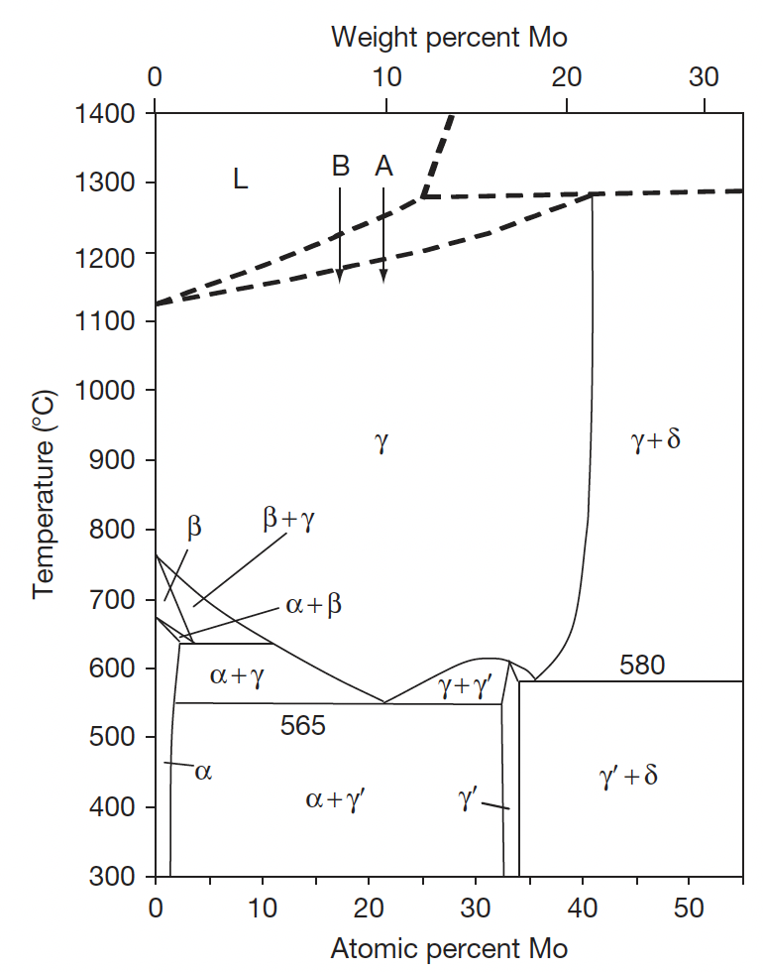
U-Mo
It was recognized early on in the development of fast reactor fuels that molybdenum is one of the strongest gamma-stabilizers of the transition-metal elements, even stronger than Zr, and that it enables alloys with U to have relatively high U density
A disadvantage of Mo as an alloying element is that it has higher neutron absorption cross sections than Si and Al, but not sufficiently significant to be problematic
The solubility of Mo extends to 22 wt% (or 41 at.%) in the gamma-phase, but it is limited to a few percent in the alpha and beta-phases.

Slide 10
UMo Phases
The gamma-phase undergoes a eutectoidal decomposition at 565C, transforming to the dual-phase mixture of the orthorhombic alpha-phase and the ordered tetragonal gamma’-phase which has the nominal stoichiometry of U2Mo
This transformation is slow when the molybdenum content is more than about 6 wt%, so a gamma-phase metastable U–Mo alloy with 6–12 wt% Mo can be obtained by quenching the alloy melt into the gamma-phase

Slide 11
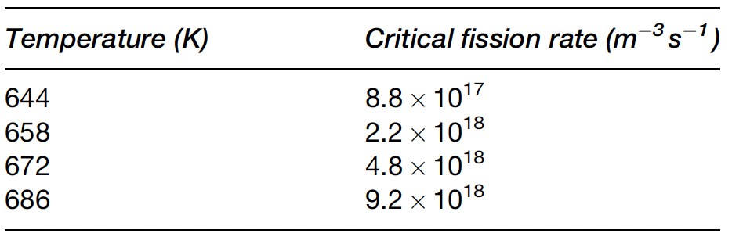
Gamma Stability
The radiation stability of U-Mo depends on its ability to retain the gamma phase
At research reactor temperatures, the gamma phase wants to transform into the alpha/gamma’ two phase system
Radiation counteracts the driving thermodynamics by disordering the gamma’ phase, retaining the gamma phase
The critical fission rate is the rate at which the minimum number of displacements that maintain the gamma-phase are in balance with the thermodynamic tendency to transform to the alpha/gamma’-phases

Slide 12
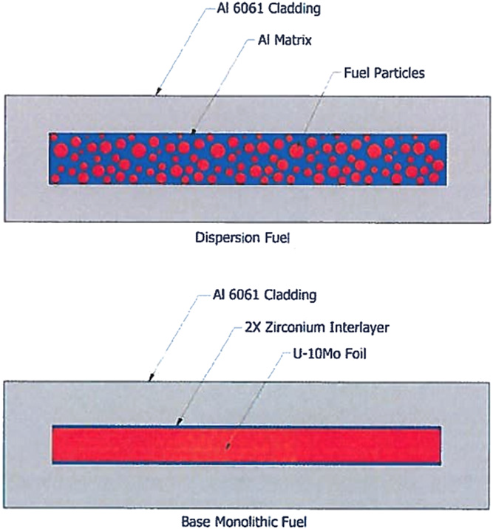
Two plate designs
Typical dispersion type fuel, U-Mo fuel particles dispersed in an Al matrix, Al cladding
Monolithic fuel foil, Zr interdiffusion barrier, Al cladding

Slide 13
U-Mo Fabrication
Dispersion fabrication is unique from monolithic fabrication
U-Mo dispersion fuels are fabricated in a similar manner to U-Si dispersion fuels
Both fragmentation and atomization processes can be applied
The U-Mo alloy is quite ductile, which poses problems for the fragmentation process
Alloys can be lightly oxidized to assist in fragmentation
The fragmented powders have more equiaxially shaped grains and a more homogeneous distribution of grains than the atomized powder fuel because there is no thermal process involved during fabrication
However, they are heavily cold-worked and contain a high concentration of dislocations which can polygonize and serve as nucleation sites for gas bubbles

Slide 14
U-Mo Fabrication
The microstructure of the atomized powder consists of a ‘cellular’ solidification structure which is commonly found in rapidly cooled alloys that have a pronounced solidus–liquidus gap
Mo-rich phases solidify first upon cooling
As the cooling progresses, the solid phase volume increases, while, simultaneously, the Mo content in the solid phase decreases
If cooling is too rapid, Mo rich islands will form inside a network of a Mo lean matrix

Slide 15
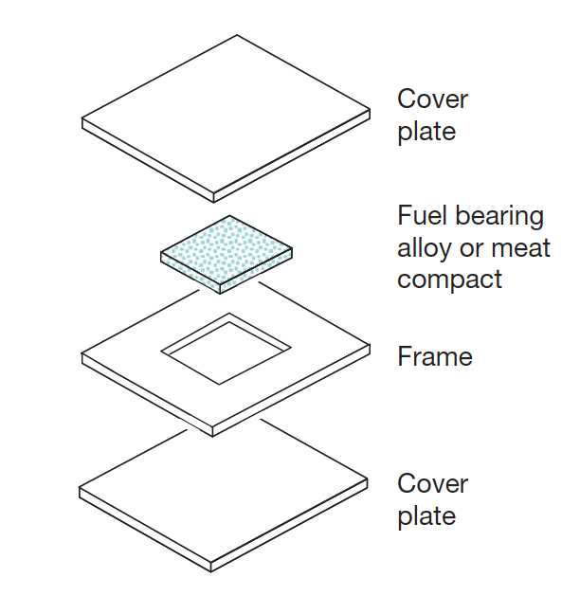
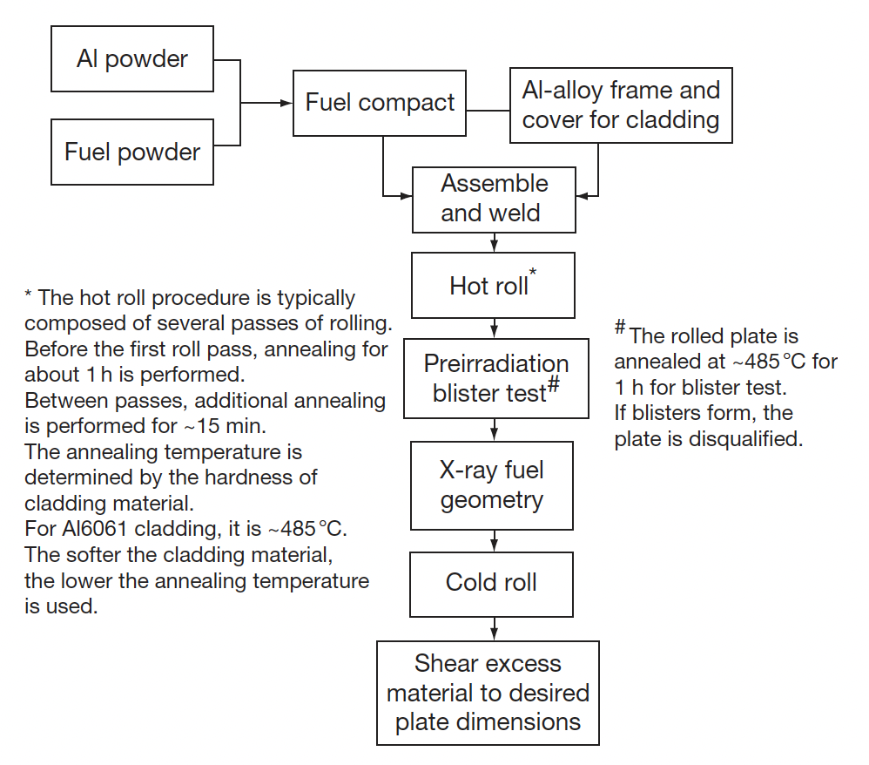
U-Mo Fabrication
The U–Mo fuel uses the same plate fabrication method as other U intermetallic fuels
However, the hot rolling procedure can have significant effects on the performance of the fuel
The thermal process changes particle characteristics and can enhance the interaction between the particles and the matrix

Slide 16
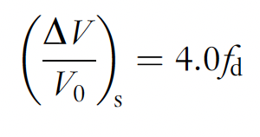
Fuel Swelling
Fuel swelling by solid fission products is also applicable for U-Mo fuels
The fuel swelling due to fission gases is unique in the UMo system
U–Mo swelling, specifically, swelling by gas bubble growth, is known to have two distinct rates: slow at low burnup and much faster at high burnup
The phenomenon underlying the transition is grain refinement or ‘recrystallization’ of the gamma-phase U–Mo
After this transition, gas bubble agglomeration accelerates, resulting in faster swelling

Slide 17
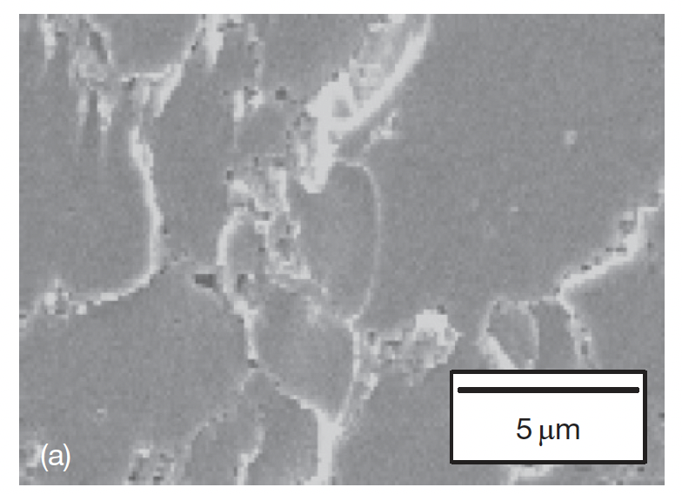
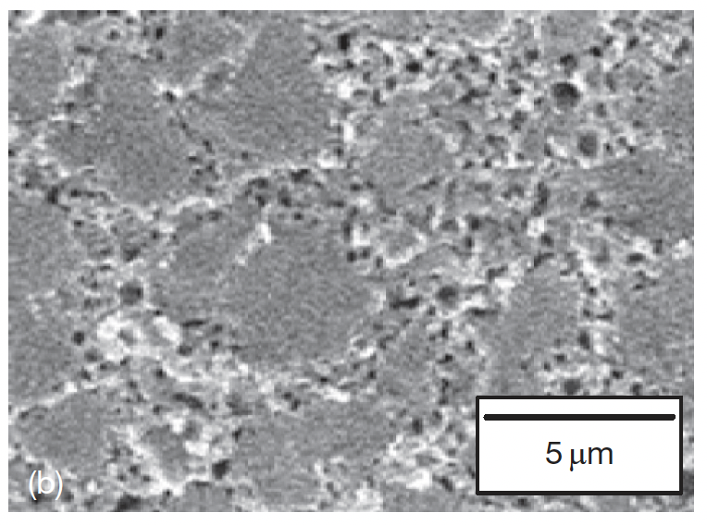
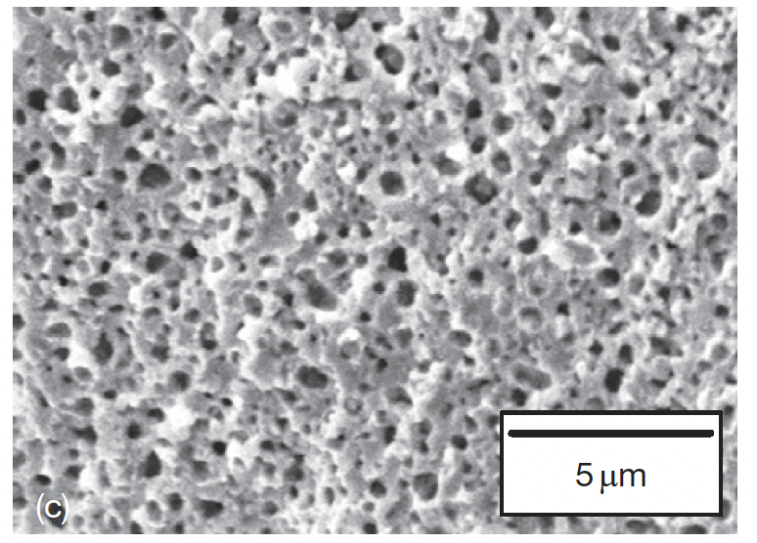
Recrystallization + Swelling
The evolution of fuel microstructure by fission gas bubble formation and growth is shown with three different burnups
In an SEM, fission gas bubbles first appear along grain boundaries, with no large bubbles in the fuel
35% BU
65% BU
80% BU

Slide 18
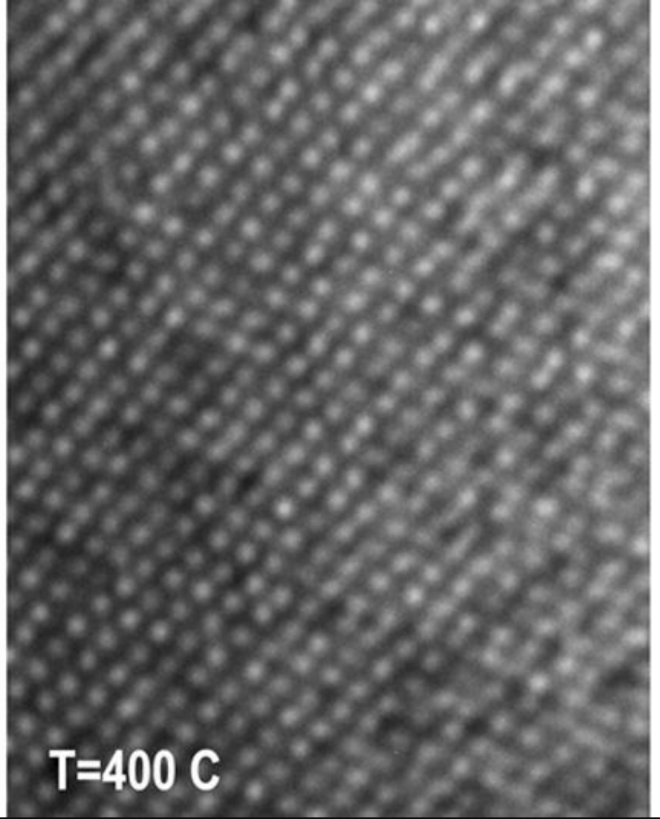


Fission Gas Superlattice
TEM analysis has identified in the low BU regime a fission gas superlattice of 2nm bubbles
As the bubbles are small, even though their number density is large, these bubbles are too small to produce much fuel volume increase
The Young-Laplace equation denotes a force balance, and the ideal gas law gives an approximation of the pressure
Thus, these small bubbles are highly pressurized and contain large amounts of gas

Slide 19
Recrystallization + Swelling
As burnup increases (2.5–3.5E27 fissions/m3), the bubble population increases in the grain boundaries and additional bubbles progressively appear at newly formed grain boundaries as grain refinement proceeds
At this stage, the average bubble size also increases with fission density as the number density increases, both of which increase the fuel swelling rate
35% BU
65% BU
80% BU

Slide 20
Recrystallization + Swelling
At higher burnup, large bubbles uniformly span the entire fuel cross section as the grain refinement is nearing completion
35% BU
65% BU
80% BU

Slide 21
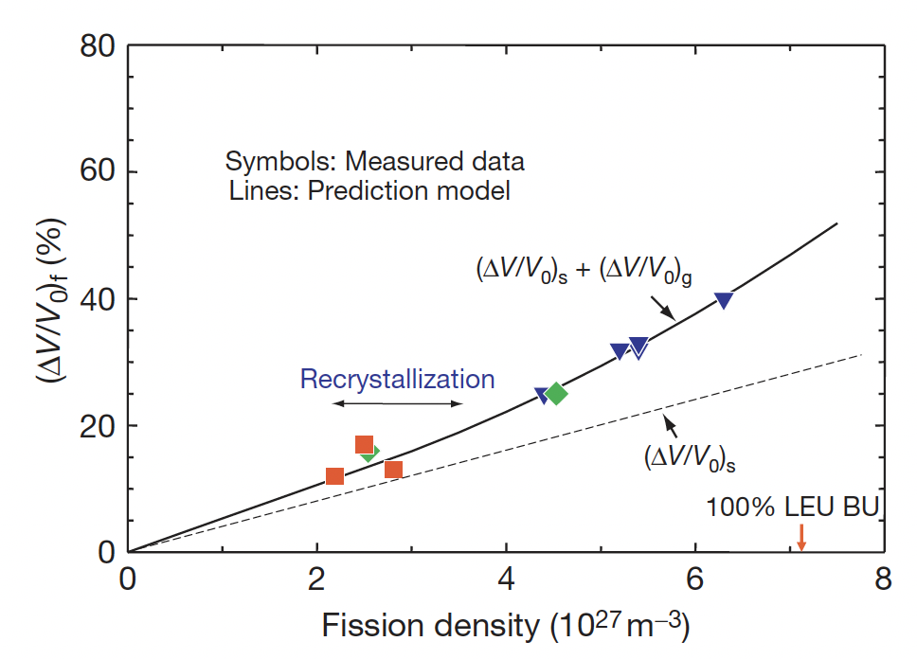
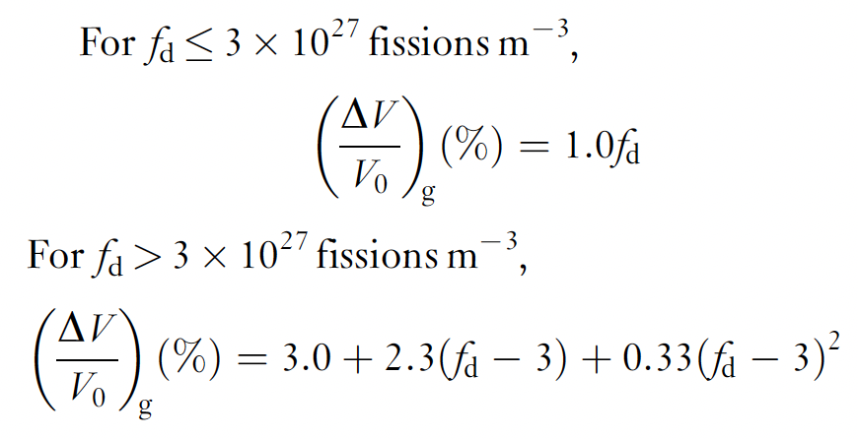
U-Mo Gaseous Swelling
Total swelling of U–Mo fuel is obtained from plate thickness changes before and after irradiation
The gas bubble swelling is obtained by subtracting the solid fission product swelling
The data can be fit to a linear function at low fission density, and a quadratic function at higher fission density

Slide 22
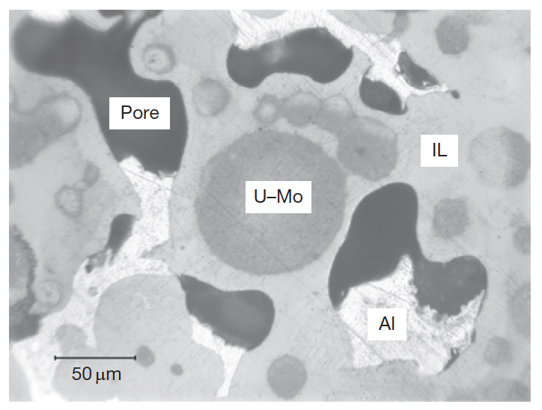
UMo-Al Interaction
The interaction layer (IL) formation between U–Mo fuel particles and matrix Al poses potential fuel failure risks
Pores tend to form in thick ILs
Variable composition of the IL is possible because of its amorphous nature during irradiation
Amorphization is usually accompanied by an increase in volume that facilitates atomic mobility, enhancing diffusion

Slide 23
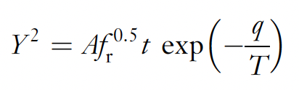
UMo-Al Interaction
The IL growth correlation follows a parabolic law, dependent upon the fission rate, temperature, and time
The Al/(U+Mo) ratio of the interaction product in the (U–Mo)–Al dispersion from out-of-pile tests is in the range 3.5–7.6
Based upon our knowledge of the U-Al system, the Al/U ratio is 2, 3 or 4
Thus, Mo is facilitating the formation of higher Al content compounds
As the Mo content increase, , the formation of (U,Mo)Al3, is suppressed, and the Al content in the IL increases
The formation of high-Al content IL is unfavorable because: 1) its lower density, leading to more swelling; and 2) high Al content linked to IL pore development

Slide 24
Alloying Additions
A method to suppress the formation of UAl4 in the U–Al system depends on finding an element to suppress the peritectoid reaction UAl3 + Al ->UAl4
There are a number of additives which have been identified to inhibit this reaction, most notably Ge, Si, Sn, and Zr
In the US, Si was primarily investigated in UMo dispersion fuels to inhibit Al4 formation and suppress IL growth
Si dramatically reduces the IL thickness
The ILs of Si-added plates are commonly uneven, with different thicknesses on different particles
This is due to the non-uniform concentration of Si
At higher burnups, the IL continues to grow and the effect of Si is weakened

Slide 25
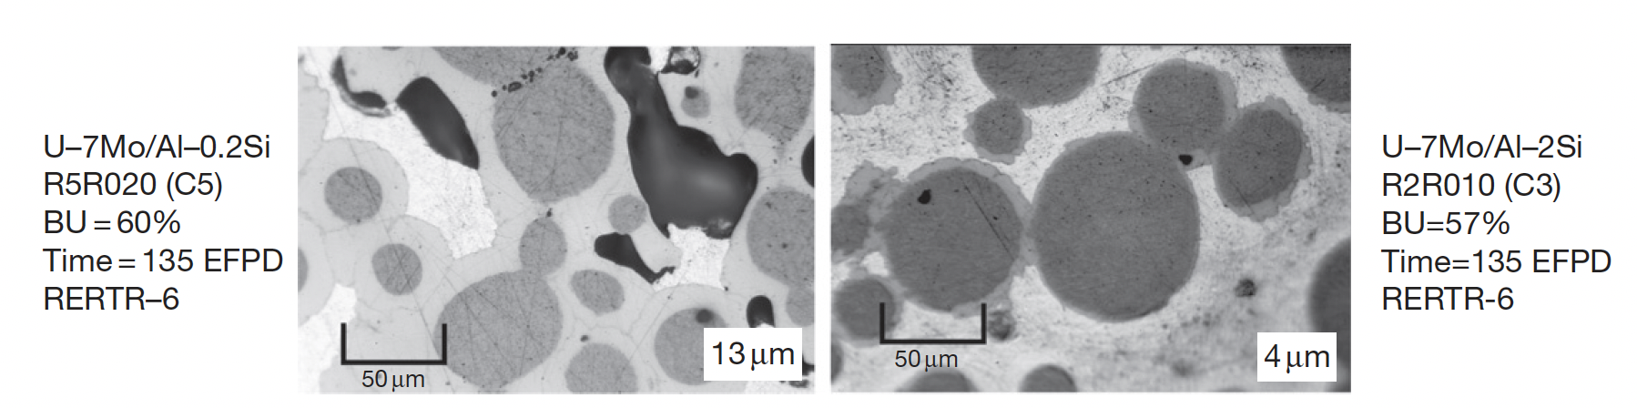
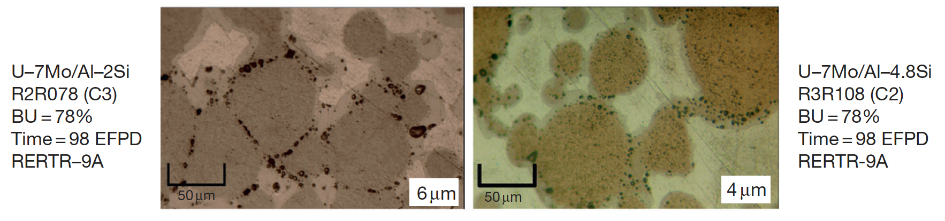
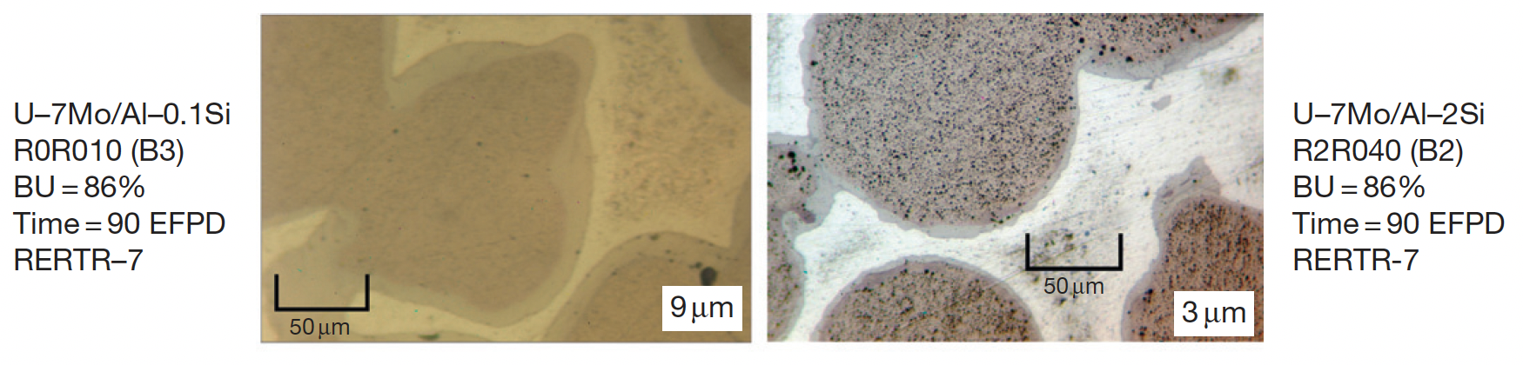
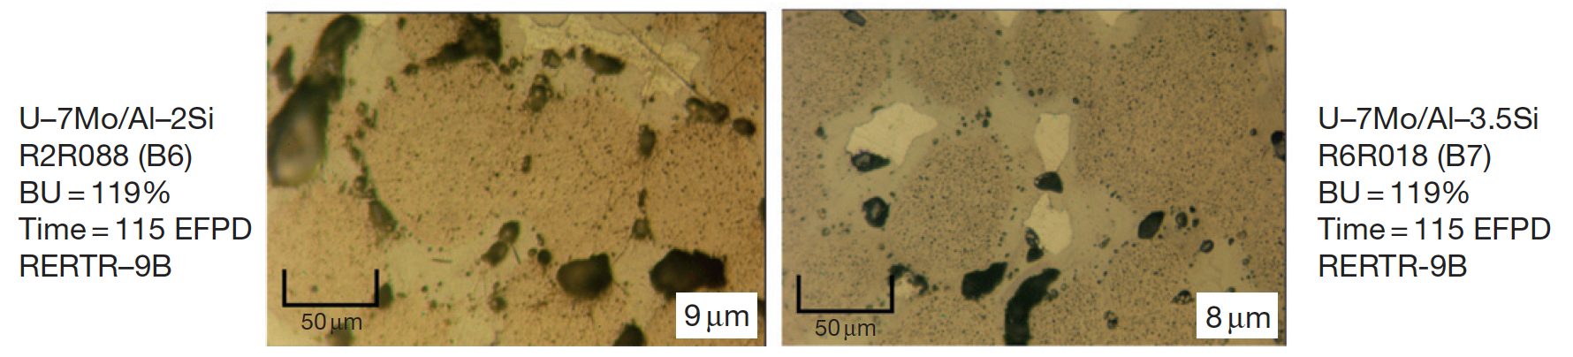
Addition of Si

Slide 26
U-Mo Dispersion to Monolithic
Higher power, high-burnup testing of aluminum matrix U-Mo dispersion fuel revealed a pattern of breakaway swelling behavior at intermediate burnup
Breakaway swelling is defined by a rapid or unpredictable transition to high swelling behavior
This swelling behavior was due to interaction of the fuel particles with the Al matrix, forming (U,Mo)Al compounds
Large fission gas bubbles can form in these phases, weakening the fuel and exerting gas pressure, potentially resulting in fuel failure
To remove this (U,Mo)Al phase, we can: 1) coat the particles; 2) modify chemistry (such as by adding Si); 3) substitute the Al matrix with another materials; 4) remove the matrix

Slide 27
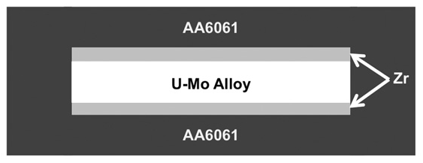
Monolithic Fuels
The U–Mo monolithic fuel, in which a U–Mo thin foil is sandwiched between a Zr liner and directly bonded to cladding, is currently under development
This fuel design has the advantage of providing higher U density than the dispersion form while essentially eliminating the problem related to reaction products between the fuel and matrix
Si additives were tried, but led to delamination of the fuel from cladding
This image is not to scale

Slide 28
Foil/Plate Fabrication
Any new nuclear fuel first requires the development of conceptual fabrication technology to prepare samples for irradiation testing
Monolithic fuel is fabricated, in general by (1) alloying and casting, (2) foil rolling, 3) bonding of the cladding, and (4) finishing and inspection for quality assurance
Fabrication processes are still being refined
Alloying is typically performed through vacuum induction melting (VIM) or arc melting of uranium and molybdenum metals at a temperature of 1300 1500C.
The molten alloy is typically cast into a coated graphite book mold
The casting is surface machined into a ‘coupon’ of the appropriate size for reduction into a foil though hot and cold rolling

Slide 29
Foil/Plate Fabrication
Foil fabrication involves reducing the thickness of a cast alloy coupon to the desired fuel foil thickness while simultaneously bonding the Zr barrier layer to the surface of the U-Mo
Hot rolling operations are conducted with the alloy temporarily encapsulated in a steel rolling can
This allows the material to be heated to 650C in air without oxidizing the fuel alloy and the Zr
After decanning, the resulting U-10Mo fuel foil, bonded to two thin (0.025 mm) layers of zirconium, sandwiched between two sheets of aluminum and placed in a steel can for HIP (Hot Isostatic Press) processing
The HIP process is typically conducted at a temperature of 560C for a time of 90 minutes or longer
The HIP can is cut open; the bonded plates are removed, and the plates are finished to final dimensions and inspected

